Slide 1
Case 1-1 (Gravity filling)
Case 1-2 (Suction filling)
0.020 s
0.060 s
0.100 s
0.140 s
0.180 s
0.220 s

Slide 2
0.020 s
0.060 s
0.100 s
0.140 s
0.180 s
0.220 s
Case 1-2 (Suction filling)
Case 1-1 (Gravity filling)

Slide 3
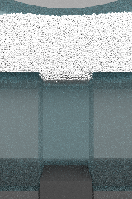
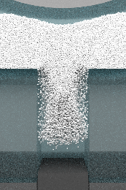
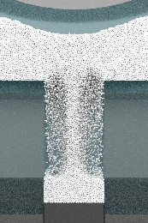
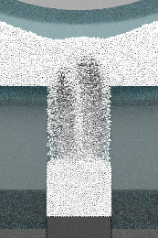
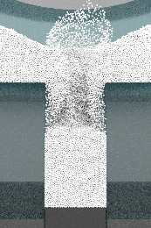
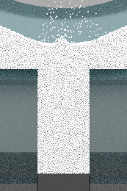
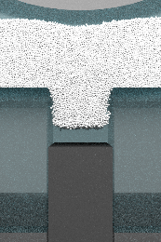
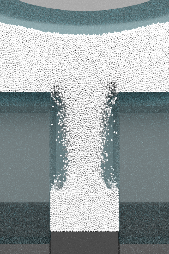
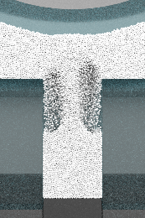
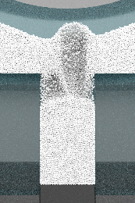
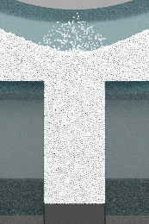
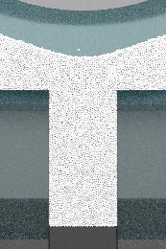
Case 1-1 (Gravity filling)
Case 1-2 (Suction filling)
0.020 s
0.060 s
0.100 s
0.140 s
0.180 s
0.220 s

Slide 4
0.020 s
0.040 s
0.060 s
0.080 s
Case 1-1
(Gravity filling)
Case 1-2 (Suction filling)

Slide 5

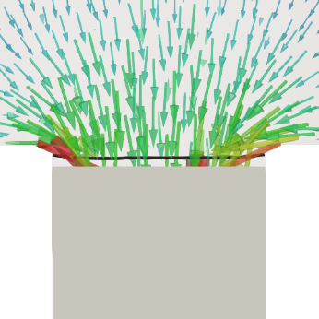
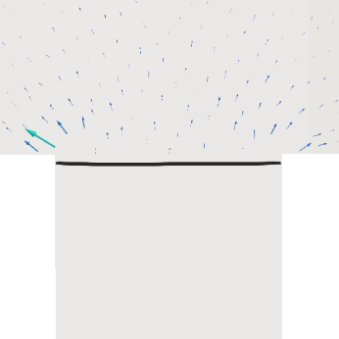
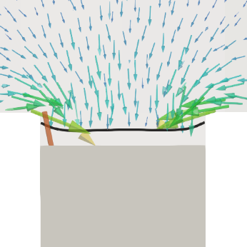
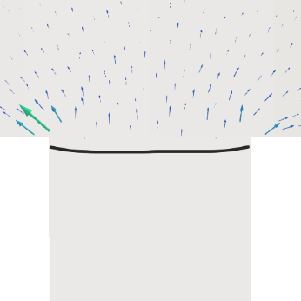
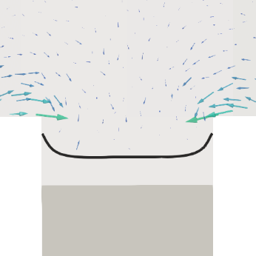
0.002 s
0.004 s
0.008 s
Case 1-1
(Gravity filling)
Case 1-2 (Suction filling)

Slide 6
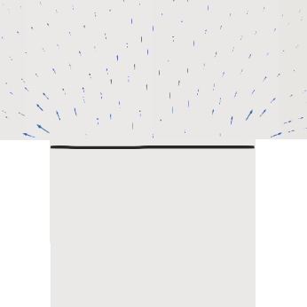
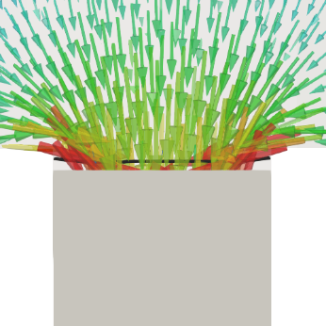
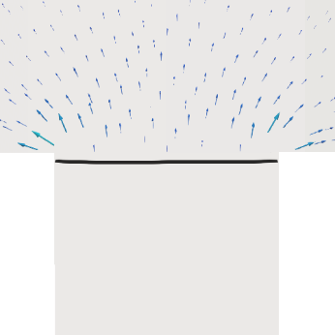
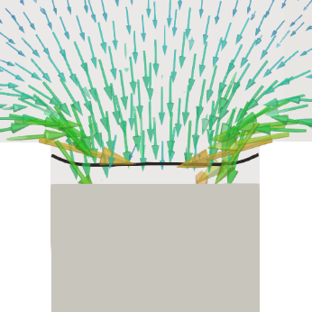
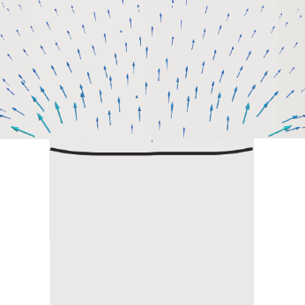
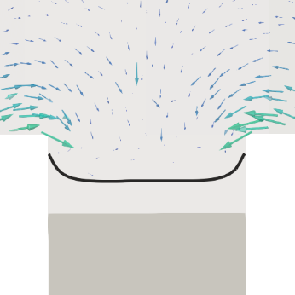
0.002 s
0.004 s
0.008 s
Case 1-1
(Gravity filling)
Case 1-2 (Suction filling)

Slide 7
Case 2-1 (100 mm/s)
Case 2-3 (300 mm/s)
Case 2-5 (500 mm/s)
Case 2-7 (700 mm/s)
0.020 s
0.060 s
0.100 s
0.140 s
0.180 s
0.220 s

Slide 8
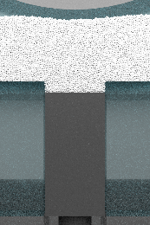
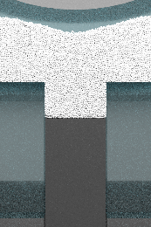
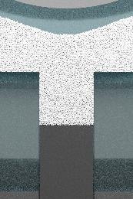
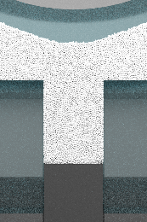
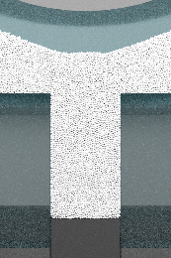
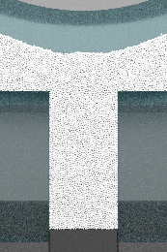
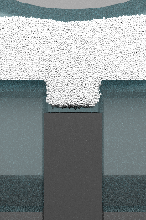
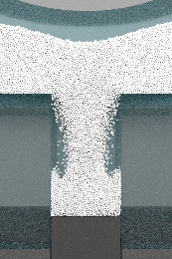
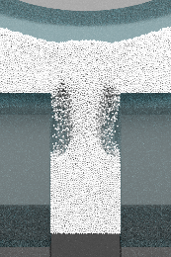
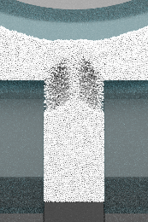
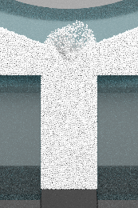
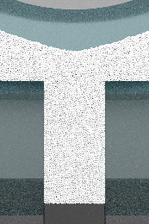
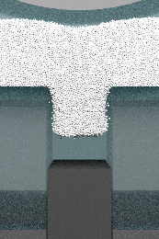
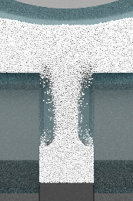
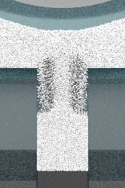
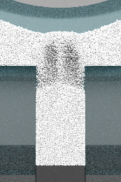
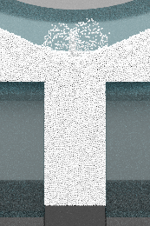
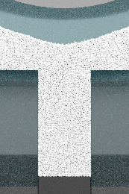
Case 2-1 (100 mm/s)
Case 2-3 (300 mm/s)
Case 2-5 (500 mm/s)
Case 2-7 (700 mm/s)
0.020 s
0.060 s
0.100 s
0.140 s
0.180 s
0.220 s

Slide 9
0.002 s
0.004 s
0.008 s
Case 2-3
(300 mm/s)
Case 2-5
(500 mm/s)
Case 2-7 (700 mm/s)

Slide 10
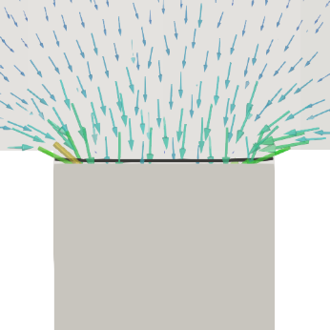
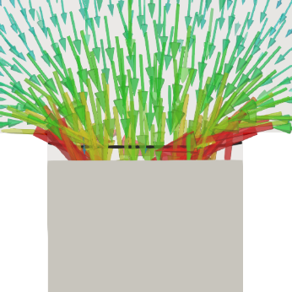
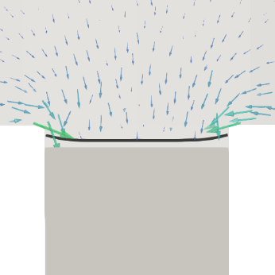
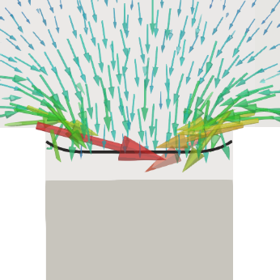
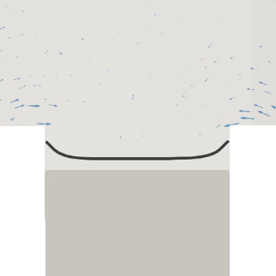
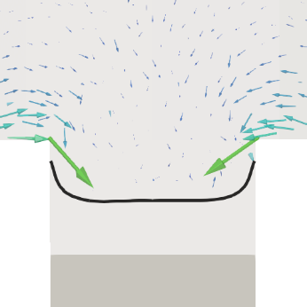
0.002 s
0.004 s
0.008 s
Case 2-3
(300 mm/s)
Case 2-5
(500 mm/s)
Case 2-7 (700 mm/s)

Slide 11
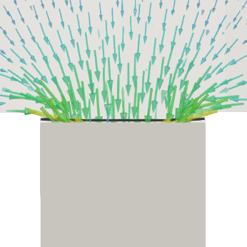
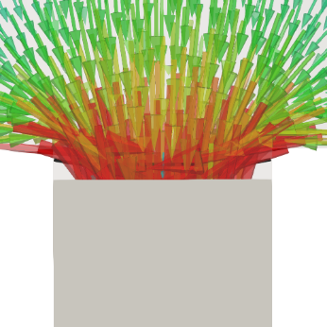
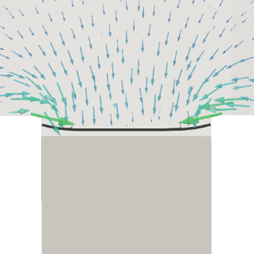



0.002 s
0.004 s
0.008 s
Case 2-3
(300 mm/s)
Case 2-5
(500 mm/s)
Case 2-7 (700 mm/s)

Slide 12
0.070 s
0.090 s
0.110 s
0.130 s
Case 2-3
(300 mm/s)
Case 2-5
(500 mm/s)
Case 2-7 (700 mm/s)

Slide 13










0.070 s
0.080 s
0.090 s
0.100 s
Case 2-3
(300 mm/s)
Case 2-5
(500 mm/s)
Case 2-7 (700 mm/s)

Slide 14












0.080 s
0.100 s
0.140 s
0.160 s
Case 2-3
(300 mm/s)
Case 2-5
(500 mm/s)
Case 2-7 (700 mm/s)

